Slide 1
408216 Data Mining and Knowledge Engineering
Experimental Analysis

Slide 2
Learning Outcomes
Discuss error estimation techniques
Discuss methods for comparing the performances of different mining schemes
Examine practical methods of training and testing mining schemes

Slide 3
Evaluation: the key to success
How good is the model that we have learned in terms of future predictions?
Error on the training data is not a good indicator of performance on future data
  Otherwise 1-NN would be the optimum classifier!
Simple solution that can be used if lots of data is available:
  Split data into training and test set
However, often good quality data is limited
  More sophisticated techniques need to be used

Slide 4
Training and Testing
Test set: set of independent instances that have played no part in formation of classifier
Assumption: both training data and test data are representative samples of the underlying problem
Test and training data may differ in nature
Example: classifiers built using customer data from two different towns A and B
  To estimate performance of classifier from town A in completely new town, test it on data from B

Slide 5
Making the most of the data
Generally, the larger the training data the better the classifier (but returns diminish)
The larger the test data the more accurate the error estimate
Holdout procedure: method of splitting original data into training and test set
  Dilemma: ideally we want both, a large training and a large test set

Slide 6
Predicting Performance
Assume the estimated error rate is 25%. How close is this to the true error rate?
Depends on the amount of test data
Prediction is just like tossing a coin a number of times
  “Head” is a “success”, “tail” is an “error”
In statistics, a succession of independent events like this is called a Bernoulli process
Statistical theory provides us with confidence intervals for the true underlying population

Slide 7
Confidence Intervals
We can say: p lies within a certain specified interval with a certain specified confidence
Example: S=750 successes in N=1000 trials
Estimated success rate: 75%
  How close is this to true success rate p?
    Answer: with 80% confidence p ∈[73.2,76.7]
Another example: S=75 and N=100
  Estimated success rate: 75%
  With 80% confidence p∈[69.1,80.1]

Slide 8

Computing Confidence Limits
Mean and variance for a Bernoulli trial: p, p(1- p)
Expected success rate f=S/ N
Mean and variance for f: p, p(1- p)/ N
For large enough N, f follows a normal distribution
c% confidence interval [- z ≤X ≤ z] for random variable with 0 mean is given by:
For a symmetric (normal distribution) we have:

Slide 9
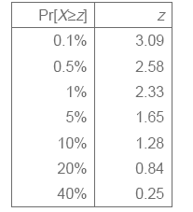

Confidence Limits
Confidence limits for the normal distribution with 0 mean and a variance of 1:
Thus:
To use this we have to transform our random variable f to have 0 mean and unit variance

Slide 10



Transforming f
Transformed value for f:
(i.e. subtract the mean and divide by the standard deviation)
Resulting equation:
Solving for p:

Slide 11


Examples
f=75%, N=1000, c=80% (so that z=1.28):
f=75%, N=100, c=80% (so that z=1.28):
Note that normal distribution assumption is only valid for large N (i.e. N > 100)

Slide 12
Holdout Estimation
The holdout method reserves a certain amount for testing and uses the remainder for training
  Usually: one third for testing, the rest for training
Advanced version uses stratification
Ensures that each class is represented with approximately equal proportions in both subsets

Slide 13
Repeated Holdout Method
Holdout estimate can be made more reliable by repeating the process with different sub-samples
In each iteration, a certain proportion is randomly selected for training (possibly with stratificiation)
The error rates on the different iterations are averaged to yield an overall error rate
Still not optimum: the different test sets overlap

Slide 14
Cross-Validation
Cross-validation avoids overlapping test sets
  First step: data is split into k subsets of equal size
  Second step: each subset in turn is used for testing and the remainder for training
This is called k-fold cross-validation
Often the subsets are stratified before the cross-validation is performed
The error estimates are averaged to yield an overall error estimate

Slide 15
Cross-Validation
Standard method for evaluation: stratified ten-fold cross-validation
Why ten? Extensive experiments have shown that this is the best choice to get an accurate estimate
Stratification reduces the estimate’s variance
Even better: repeated stratified cross-validation
  E.g. ten-fold cross-validation is repeated ten times and results are averaged (reduces the variance)

Slide 16
Leave-one-out cross-validation
Leave-one-out cross-validation is a particular form of cross-validation:
  The number of folds is set to the number of training instances
  I.e., a classifier has to be built n times, where n is the number of training instances
Makes maximum use of the data
No random sub-sampling involved
Very computationally expensive

Slide 17
Comparing data mining schemes
Frequent situation: we want to know which one of two learning schemes performs better
Note: this is domain dependent!
Obvious way: compare 10-fold CV estimates
Problem: variance in estimate
Variance can be reduced using repeated CV
However, we still don’t know whether the results are reliable

Slide 18
Significance tests
Significance tests tell us how confident we can be that there really is a difference
Null hypothesis: there is no “real” difference
Alternative hypothesis: there is a difference
A significance test measures how much evidence there is in favor of rejecting the null hypothesis
Let’s say we are using 10 times 10-fold CV
Then we want to know whether the two means of the 10 CV estimates are significantly different

Slide 19
The Paired t-test
Student’s t-test tells us whether the means of two samples are significantly different
The individual samples are taken from the set of all possible cross-validation estimates
We can use a paired t-test because the individual samples are paired
  The same Cross Validation is applied twice
Let X₁, X₂, ….,X_{k} and Y₁, Y₂, ….,Y_{k} be the 2k samples for a k-fold CV

Slide 20

The distribution of the differences
Let m_{d}=m_{x}-m_{y}
The difference of the means (m_{d}) also has a Student’s distribution with k-1 degrees of freedom
Let σ²_{d} be the variance of the difference
The standardized version of m_{d} is called t-statistic:
We use t to perform the t-test

Slide 21
Performing the test
Fix a significance level α
Divide the significance level by two because the test is two-tailed
  i.e. the true difference can be positive or negative
Look up the value for z that corresponds to α/2
4. If t≤-z or t≥z then the difference is significant
  I.e. the null hypothesis can be rejected

Slide 22
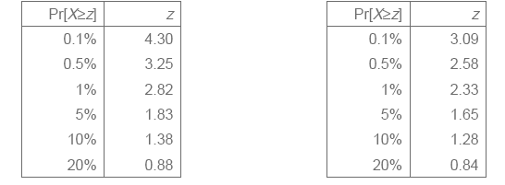
Student’s Distribution
With small samples ( k<100) the mean follows Student’s distribution with k-1 degrees of freedom
Confidence limits for 9 degrees of freedom (left), compared to limits for normal distribution (right):

Slide 23
Metrics in Classification
Precision is defined for each class and is the fraction of instances correctly classified for that class
If a classifier has predicted Y instances for a class and out of them X are correctly classified then Precision (P) =X/Y
Recall (R) is the fraction of instances that have been found for a given class
If Z instances exist for a class, then R=X/Z

Slide 24
Metrics in Classification – Labour Example
=== Stratified cross-validation ===
=== Summary ===
Correctly Classified Instances 42 73.6842 %
Incorrectly Classified Instances 15 26.3158 %
Kappa statistic 0.4415
Total Number of Instances 57
=== Detailed Accuracy By Class ===
TP Rate FP Rate Precision Recall F-Measure Class
0.70 0.24 0.61 0.70 0.65 bad
0.76 0.30 0.82 0.76 0.79 good
=== Confusion Matrix ===
a b <-- classified as
14 6 | a = bad
9 28 | b = good

Slide 25
Use of Lift in Targeted Marketing
Lift is the most effective measure in targeted marketing
Targeted marketing involves building a data mining model from historical data (past data from mass marketing campaigns)
We use the miss-classification matrix to calculate the Lift(L) metric
If L>1, then it is better to use data mining to target a small group of customers rather than sending offers to the entire population

Slide 26
Use of Lift in Targeted Marketing
Model Computed Computed
X Accept Reject
Accept 46 54
Reject 2245 7655
L = 46*10000/(46+54)(46+2245)=2.0
Since L >1, it would be much more profitable to send offers to the 2291 individuals targeted by the mining model, rather than a mass mailing campaign
The 2291 individuals can be identified by using a classifier such as Naïve Bayes to rank individuals in descending order of probability of belonging to the Accept class.
Offers would then be sent to the top 2291 individuals on this list

Slide 27
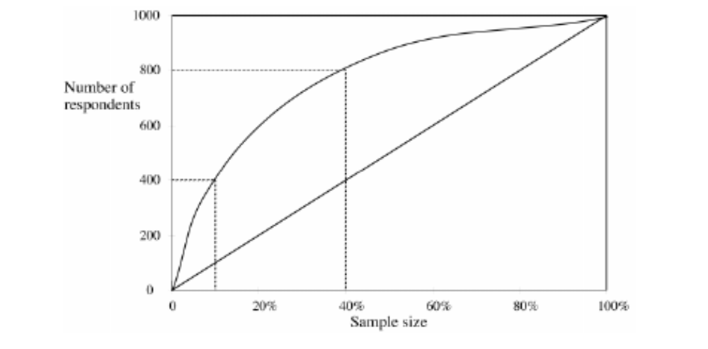
An example Lift Chart

Slide 28
Metrics in Numeric Prediction
In terms of evaluating the accuracy of numeric prediction, three metrics are commonly used
The correlation coefficient which measures the strength of the relationship between the actual and predicted values
The Mean Absolute Error (MAE)
Root Mean Squared Error (RMS)

Slide 29
Metrics in Numeric Prediction
The mean absolute error is defined by:
MAE = |P₁-A₁|+ |P₂-A₂|+…….+ |P_{n}-A_{n}|/n
The root mean square error is defined by:
RMS = sqrt((P₁-A₁)²+ (P₂-A₂)²+……..+ (P_{n}-A_{n})²/n)

Slide 30
Metrics in Numeric Prediction – CPU Example
Linear Regression Model
class =0.0661 * MYCT +0.0142 * MMIN + 0.0066 * MMAX + 0.4871 * CACH + 1.1868 * CHMAX +-66.5968
=== Predictions on test data ===
inst#, actual, predicted, error
1 56 71.671 15.671
2 80 100.322 20.322
3 253 315.892 62.892
4 82 89.132 7.132
5 46 33.11 -12.89
=== Cross-validation ===
=== Summary ===
Correlation coefficient 0.928
Mean absolute error 35.4878
Root mean squared error 57.5296

Slide 31
Metrics in Numeric Prediction
The metrics are often used to compare the performances of different numeric prediction systems (e.g. regression and multi layer perceptron).
It turns out in practice that there is good agreement between the three metrics
In the above example it turns out that Model C is the best according to all three metrics
 | Model A | Model B | Model C
Correlation coefficient | 0.88 | 0.89 | 0.91
Mean Absolute Error | 38.5 | 33.4 | 29.2
Root Mean Squared Error | 91.7 | 63.3 | 57.4

Slide 32
Metrics in Association Rule Mining
The metrics most often used are support (s) and confidence (c)
However there are sometimes problems with metrics such as confidence.
In this case other metrics such as Lift are used
The Lift metric (not to be confused with the metric used in evaluating classification) is often used in marketing
It captures the extent to which rival products are bought – for example how often is margarine bought when butter is not bought

Slide 33
Metrics in Association Rule Mining
Contingency table for X → Y
 | Y | Y
X | f₁₁ | f₁₀ | f₁₊
X | f₀₁ | f₀₀ | f_{o+}
 | f₊₁ | f₊₀ | |T|
f₁₁: support of X and Y
f₁₀: support of X and Y
f₀₁: support of X and Y
f₀₀: support of X and Y
Given a rule X → Y, information needed to compute rule interestingness can be obtained from a contingency table

Slide 34
Drawback of Confidence
 | Coffee | Coffee
Tea | 15 | 5 | 20
Tea | 75 | 5 | 80
 | 90 | 10 | 100
Association Rule: Tea → Coffee
Confidence (Tea ->Coffee ) = 0.75
but support (Coffee) = 0.9
Although confidence is high, rule is misleading
because Confidence (Tea -> Coffee ) = 0.9375

Slide 35
Example: Lift
 | Coffee | Coffee
Tea | 15 | 5 | 20
Tea | 75 | 5 | 80
 | 90 | 10 | 100
Association Rule: Tea → Coffee
Confidence (Tea ->Coffee) = 0.75 but support (Coffee) = 0.9
Lift = 0.75/0.9= 0.8333 (< 1, therefore is negatively associated)
Thus it is clear that the rule Tea → Coffee is not a high quality one, and in this case, Lift and NOT Confidence is the correct metric to be used

Slide 36
Example: Lift
Example: Lift
 | Coffee | Coffee
Tea | 15 | 5 | 20
Tea | 75 | 5 | 80
 | 90 | 10 | 100
What can you say about the quality of the rules:
Tea -> Coffee
Coffee->Tea

